Slide 1
Doing VA Claim Forms using an Apple iPad
Kevin R. Karvinen
Department Treasurer
Chapter Service Officer

Slide 2
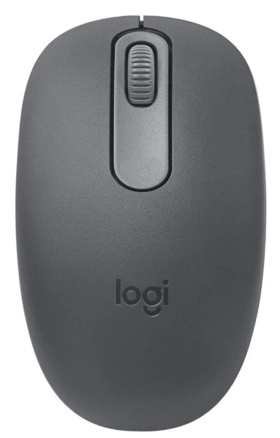
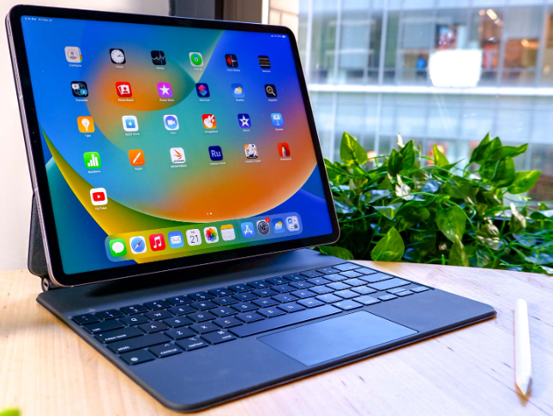
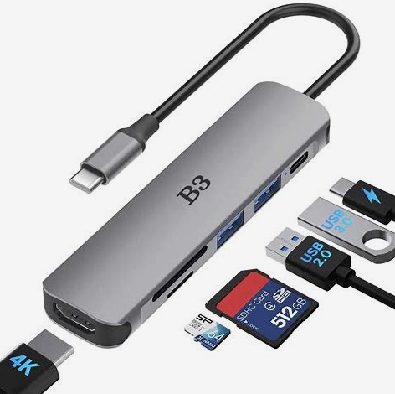
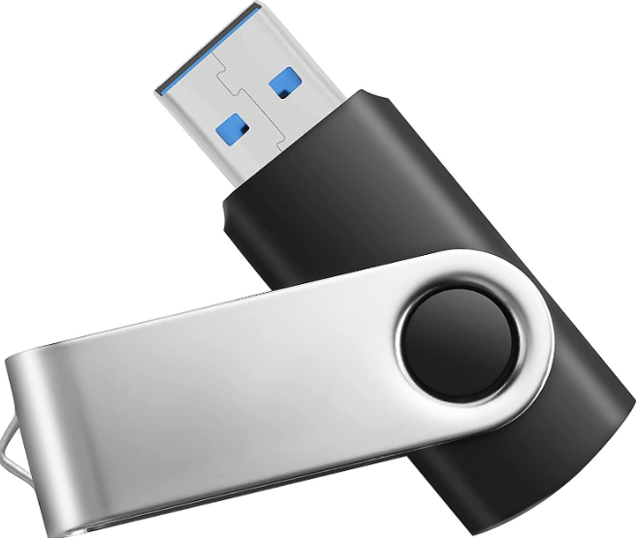
When using an iPad and paired with a flash drive, to file VA claims, there is NO need for paper and printers.
The only requirement is a connection to the internet. This can be accomplished thru Wi-Fi, a Hotspot or simply using your cell phone as a Hotspot.
When using this method, you will need the following: Apple iPad, Apple Pencil, a USB hub that uses USB-C to connect to the iPad, Flash drive (1GB recommended), and a case to protect the iPad. Optional items include a Bluetooth Keyboard and a mouse.

Slide 3
Login to cms.dav.org
Search for or add the claimant.
Open a search engine Chrome, Safari etc.
Go to va.gov/forms.
Download the forms needed to your iPad. NOTE: if using a flash drive, download the forms to the flash drive.
Fill out the required Forms and save them to the iPad or flash drive.

Slide 4
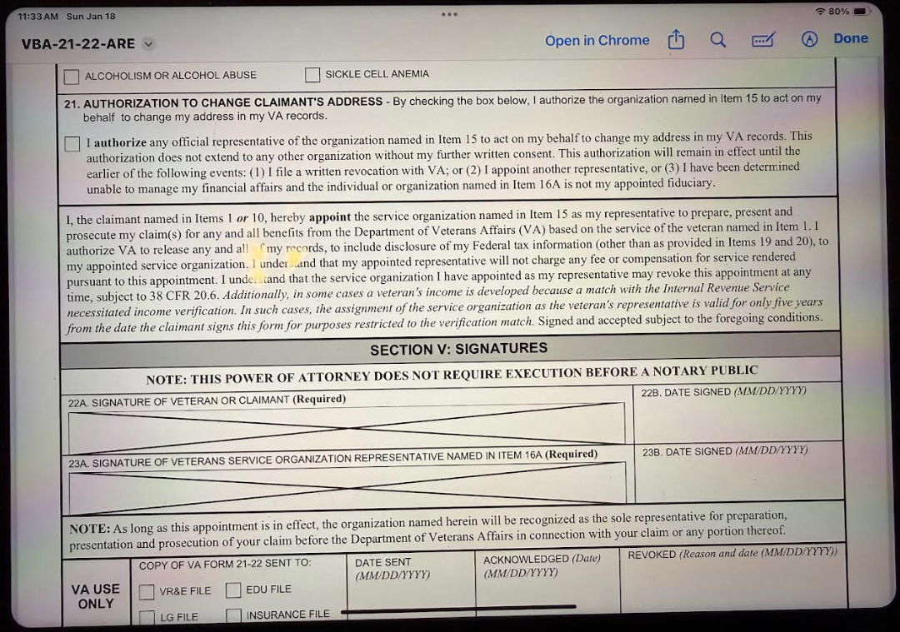
Note: Make sure the Apple Pencil is connected via Bluetooth.
Tap the tip of the Pencil on the small circle with a pen tip in it in the upper right corner of screen.
Have the client sign the form using the Pencil. When signed, tap on “Done”. Repeat for other Forms.
Tap here after form is signed.
Tap Pencil here.

Slide 5
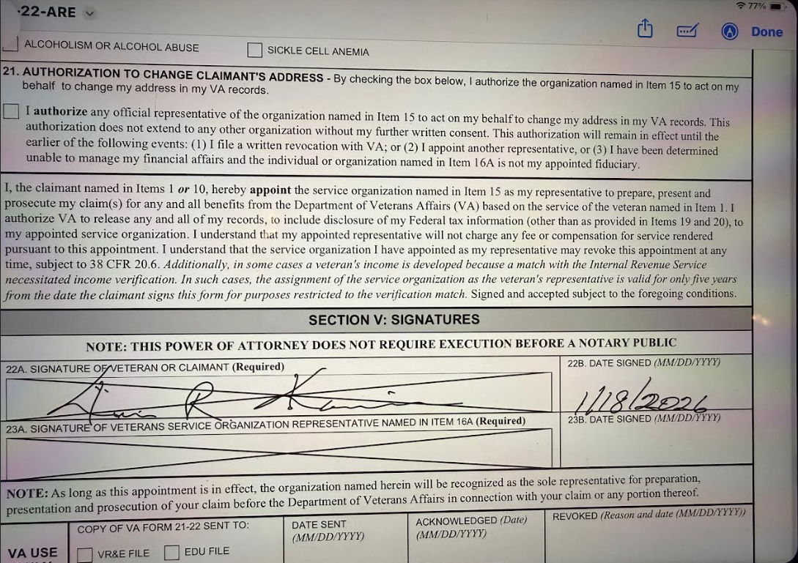
After the Form is signed, it will automatically be saved when you Tap “Done”.

Slide 6
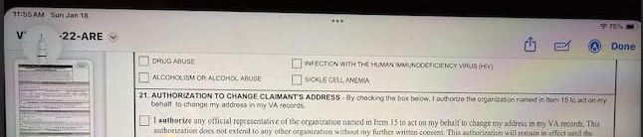
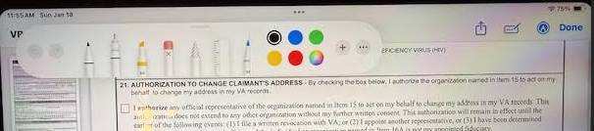
If the client makes a mistake, Tap the picture of a pen tip in the upper left corner
Tap here.
Tap on the eraser and use the Pencil to erase the mistake. Make sure to choose the Pen to resign.
Pen for signing
Eraser.

Slide 7
Using the iPad to scan in evidence
Apple has a free App called Preview that will scan in evidence utilizing the camera on the iPad.
You must have iPadOS 26.2 or newer to use Preview.
You can also use Adobe Scan which is also free.
Remove the keyboard from the case to make it easier to use the iPad camera.
Open the Preview App, tap on “Scan Documents”, center the document, adjust the iPad closer or farther away as needed. The screen will turn blue when the document has ben captured and scanned. Repeat for other documents. Save the documents to the iPad.
Return to CMS and complete the Claim process.

